Slide 1
IBM Kenexa BrassRing on Cloud Migrating to the Responsive Talent Gateways — IBM Watson Talent Client Training and Enablement February 26th, 2019

Slide 2
Agenda –
What questions do you have about migrating to the Responsive Talent Gateways?
Frequently asked questions

Slide 3
IBM sunset support for Classic Talent Gateways and the classic apply process (“Classic experience”) on December 31st, 2017. Although IBM did not shut off Classic Talent Gateways, as of that date, IBM no longer works on bug fixes specific to Classic experience. Also, IBM no longer ensures accessibility standards on anything other than the Responsive Talent Gateways and the Responsive Apply process (“Responsive experience”). All new features and functionality has been and will only be available in the responsive experience. We want to make you aware that although the Classic experience has remained functional over the last 13 months despite being unsupported, technology has and will continue to advance to the point that they may stop working as our product progresses. If they stop working, those features may be disabled. Since these are no longer supported, they will not be enhanced or updated to work with new technology.

Slide 4
Q: Why do my users have to select a Gateway Questionnaire now when posting a req? Do you have to select a Responsive Gateway Questionnaire when posting to a Responsive Talent Gateway?
A: With Release 19.02.11 all reqs that a BrassRing user attempts to post (or update a posting) to a Responsive Talent Gateway will require a GQ to be included/selected.
A Responsive GQ is not currently a requirement however selecting a Classic GQ when posting to a Responsive TG will result in a bad candidate experience.

Slide 5
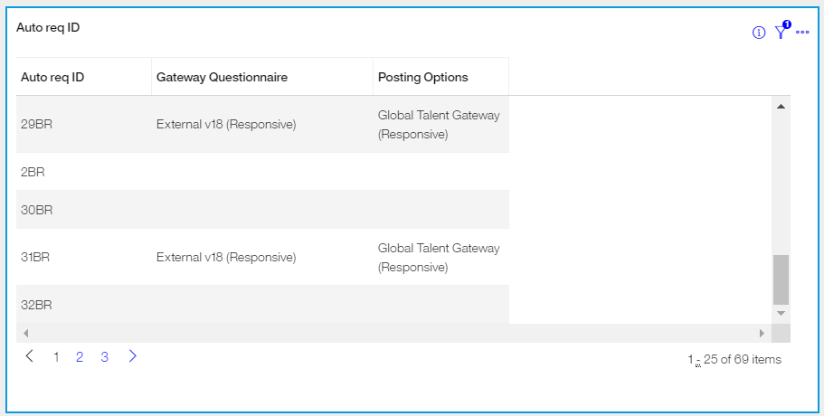
Q: How can I tell what reqs do not have a Gateway Questionnaire selected on the posting options page?
A: We recommend utilizing the BrassRing Metrics Dashboard to build a visualization to pull this information. An example visualization would be:
Table Chart type
Columns: Auto Req ID, Gateway Questionnaire, Posting Options
Optional Filter: Req Status
If you haven’t yet enabled the Metrics Dashboard, we recommend you do! Steps to enable the dashboard can be found also on the IBM Knowledge Center.

Slide 6
Q: Our Social Referral Talent Gateway is used only to refer candidates, it does not collect internal applications. Since the TG is referral only, what kind of GQ is required on the Posting Options page?
A: IBM's best practice recommendation is to add the Social Referral functionality to your Internal Talent Gateway and not have a separate 'referral' gateway. Taking this approach provides your internals one place to go to apply to jobs they may be interested in or refer someone for a position. We understand that some clients have chosen to implement separate Talent Gateways for these functions (internal apply and referrals) by using CSS to hide the apply button on a Social Referral TG.
If your organization currently chooses to have separate TGs, the Gateway Questionnaire selection will still be a requirement of the Social Referral Talent Gateway on the Posting Options page. The reason it is required is because, based on best practice, the GQ that would be selected would be used in a TG that served the dual-purpose (as the internal apply GQ). The GQ selected on the Posting Options for a single-purpose Social Referral TG (referral process only) will not be used for any purpose, there simply needs to be a GQ selected to fulfill the posting requirement.

Slide 7
Q: Our organization uses Classic Talent Gateways for our Referral program. How do we migrate the classic referral functionality to Responsive?
A: The classic referral functionality available on the Classic TGs is not supported on the Responsive Talent Gateways. In order to have a responsive referral program you will need to implement the Social Referral functionality.
For the latest configuration information about Social Referral, visit the IBM Knowledge Center.
Please note:
IBM recommends that you review all documentation and watch the relevant videos on the Knowledge Center before implementing Social Referral. There are decisions in which your organization will have to make before rolling this out.
We advise against implementing Social Referral directly in Production without configuring and testing in Staging first.

Slide 8
Q: Our organization has a WOTC (Work Opportunity Tax Credit) TG – we need to post reqs to this ‘hidden’ TG in order to collect WOTC information after the initial apply process. What should we do once the requirement is put in place that a GQ is required (we do not currently select a GQ for this TG)?
A: You are able to create a GQ with a WOTC widget included. When BrassRing requires a GQ at posting, you will want to have a GQ (that has a WOTC widget) created for your users to select.

Slide 9
Q: Do Add Candidate/Contact (basic) Gateways need to be migrated to responsive?
A: Not currently. This exercise is only for FULL TGs. IBM is currently working on an option that will replace Basic Talent Gateways. For the time being, if clients share a basic TG URL with their candidates to fill complete, they can create a Responsive Standalone Gateway Questionnaire instead and provide that link to the candidates. Please check out the information found on the IBM Knowledge Center to accomplish this.

Slide 10
Q: On the TG's there is a section to select default questions. What is best practice to for these questions? Move them to a GQ and deselect on the TG, or leave them off the GQ and only selected on the TG?​
A: If these questions should be asked of all candidates that apply through the TG, but still should allow your Recruiters to score or remove them, we recommend to leave them as Talent Gateway default questions. Then make sure there is a Job Specific Questions (JSQ) widget added to your Gateway questionnaire. The default questions will be shown to your Recruiters on the Edit Site Questions page in BrassRing where they can score them or remove them. Those questions will then be pulled into the GQ wherever you have the JSQ widget added.
If these questions should be asked of all candidates that apply through the TG and if you don’t want your Recruiters to remove or score the questions, we recommend removing them from the default questions and adding them to the GQ. These questions are not shown to the Recruiters on the Edit Site Questions page in BrassRing and they cannot remove them.

Slide 11
Q: Is it possible to update the question source Library after the Gateway Questionnaire is active and Talent Gateway is synched? How do I update the Library? I need to make some changes to the text but can't seem to find where.
A: If you are referencing the questions that are present on the "Edit Site Questions" page within the Posting Options page, then you can find those in Workbench under Tools > Forms > Candidate Forms > Administer form fields for the Talent-Gateway form.
The "Talent-Gateway" form is your question library for questions that can be pulled in when posting a job to the Talent Gateways. You can add/edit questions there. If you have a Gateway Questionnaire that is Active and you want to update your questions, you can update those in Workbench and then you will have to update the existing postings manually to update the questions. As long as your Gateway Questionnaire has a Job Specific Questions widget, it will pull in the questions that you select on the Edit Site Questions page.

Slide 12
If testing the Saved Search functionality in Staging, please note that emails are not sent.
If your Attachments widget page does not have an upload option, this is most likely because you do not have attachment categories selected on your GQ.
Job Cards will drop off of a candidate’s submitted applications page if the Req Status = Closed (Cancelled or Deleted) and the candidate’s HR Status hasn’t been updated in 90 days.
The signature widget that was available in Classic GQs is not supported in the responsive GQs. Electronic signatures have not changed with Responsive Apply. Most clients are using a combination of a checkbox and text box for the candidate to type their name. The drawn signature that was available in Classic is not supported in Responsive.
Tips
Testing should include (at a minimum): Header and footer links, advanced search fields, job description layout, field branching within the application, WOTC/Assessments/APIs (where applicable), Social Media functionality (Google Drive, Drop box, LinkedIn, Facebook, Twitter), Candidate Zone pages.
It is recommended that you place the education and experience widgets on the same page as the contact fields. The resume/CV widget should follow on the next page. The Import Profile button is what is used to prefill/parse the candidate’s information into the contact fields and education/experience widgets.
On the Candidate Zone, the “Last Update” date is based on the HR Status Category date change not the date the HR Status was changed.

Slide 13
If your organization currently uses iFrames, please be aware that iFrames are not technically supported on Responsive Talent Gateways. Adding custom CSS and coding does not guarantee that the Responsive Talent Gateway will render properly on mobile devices. Also, an attempt to implement an iFrame may result in the iFrame taking up too much screen space when candidates are on smaller devices. This then leads to a less than optimal candidate experience.
If you would like to remove certain options from a field on the Advanced Search page, edit the Talent Gateway and select the “Choose field options” field.
The “more” option on the job search results page will not render HTML from the formatted descriptions
Tips
Videos can be added, by using HTML, to the Candidate Zone via the HR Status Category descriptions.
HR Status Categories are displayed to candidates within the Candidate Zone. These HR Status Categories can be customized per Responsive Talent Gateway.
Jobs pushed to a third party, through a Job Board Aggregator or through the IBM Jobs API, should not be impacted.
If your organization currently uses a Vanity URL, these should not be negatively affected by the conversion to Responsive.
Welcome text color is limited to ensure that it contrasts with the color of the foreground color.

Slide 14
Resources
IBM Knowledge Center
Overview, Configuration and Documentation
Project overview
Configuration overview
Responsive Apply Design Sheet: This document is referenced in the Project Process Overview and Visual Branding Tool Overview webinars. It is recommended to use this document to collect pertinent information from your Marketing or Corporate Communications team.
Responsive Upgrade LOE Assessment: This spreadsheet helps you estimate the number of hours that are needed by your Workbench Administrator to make the move to Responsive Apply.
Advanced CSS Snippets
Responsive Apply Tracking Codes for Apply Process
Migrating to the Responsive TGs FAQ: https://ibm.box.com/s/bjevqdxo952bvdi7kxgdgwr8zh3v8775

Slide 15
Questions?

