Slide 1
T-Mobile RAM Usage
Chrissy Lazzerini 6/25/2020

Slide 2
Agenda
RAM Impact and efficiency
Did you know…..
Close and disposition RAM
Auto Un-post RAM

Slide 3
RAM Impact & Efficiency

Slide 4
Communications Sent
575,518 Communications sent YTD (June 9, 2020)
551,975 by RAM
Communications sent the most
Thank you for Applying – Internal and External applicants
Assessment Reminder
RAMs that sent the most communications
Amount of time needed to send manually
551,975*30 = 16,559,250 seconds
574.97 days
114.99 weeks
~2.21 FTE dedicated to send manually
Trigger Name | # of Triggers run | # of Rules per Trigger | Total # of Rules run | # of Communications Sent
HR Status - Needs Assessment | 180,507 | 22 | 397,1154 | 200,492
CF-Recruiter Rejected | 168,914 | 5 | 844,570 | 136,336

Slide 5
RAM Efficiency
2020 YTD Usage: 1/1/2020 - 6/9/2020
75 RAMs in use
Days of work saved: ~1762
Weeks of work saved: ~352
Work saved of approx. 7 FT employees
2019 Usage: 1/1/2020 - 12/31/2019
75 RAMs in use
Days of work saved: ~5122
Weeks of work saved: ~1024
Work saved of approx. 20 FT employees
2020 RAM Savings
Estimate each FTE makes approx. $50k-$100k
RAM usage equates to the work of approx. 7 FTE
Approx. YTD savings due to RAM usage:
$350,000—$700,000*
2019 RAM Savings
Estimate each FTE makes approx. $50k-$100k
RAM usage equates to the work of approx. 20 FTE
Approx. annual savings due to RAM usage:
$1,000,000—$2,000,000*
*Each amount is an estimate only. Actual figures depend on various factors like location and role of employee that would be doing the work. Also varies based on hiring volumes

Slide 6
Did You Know?
A RAM can be used……
In conjunction with different Workflows
Helps to simplify conditions
Allows for more customized recruiting process
Can be combined with other conditions
Ex. Workflow, HR Status, and positions remaining
Just imagine what other magical things you can do with a RAM!

Slide 7
Some cool RAMs

Slide 8
Close Requisitions and Disposition
How does this work?
When final HR Status is selected AND number of positions remaining is 0
Screen pop to ask if you want to close the req
If yes, req will proceed to close and all candidates already not dispositioned will be rejected
With rejected status change, a disposition form is added with proper reason code based on the status the candidate was in prior to rejected
2020 YTD Data
Trigger Name | # of Triggers run | Rules per Trigger | Total # of Rules run
Req Status Closed - Professional | 131,288 | 4 | 525,152
Req Status Closed - Retail | 53,155 | 4 | 212,620
Req Status Closed - Care | 48,185 | 4 | 192,740
2019 Data
Trigger Name | # of Triggers run | Rules per Trigger | Total # of Rules run
Req Status Closed - Professional | 246,981 | 4 | 987,924
Req Status Closed - Retail | 263,131 | 4 | 1,052,524
Req Status Closed - Care | 87,468 | 4 | 349,872

Slide 9
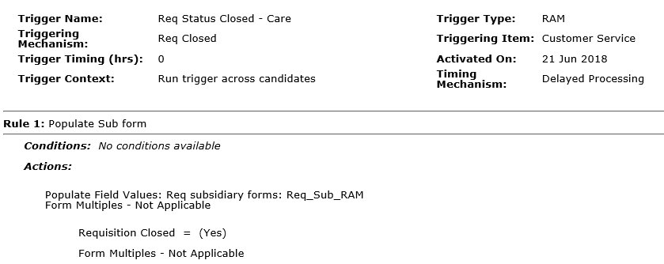
RAM Configuration

Slide 10
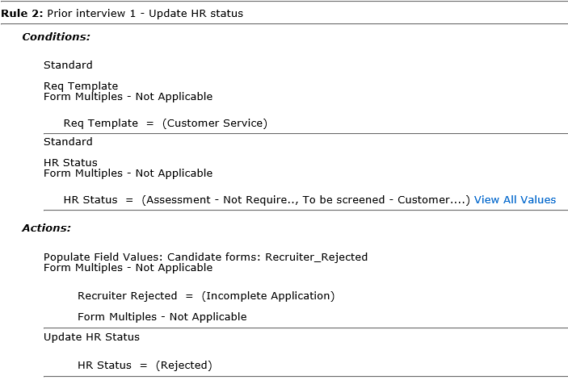
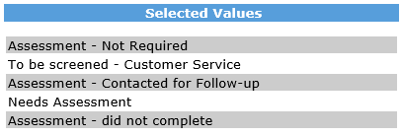
RAM Configuration

Slide 11
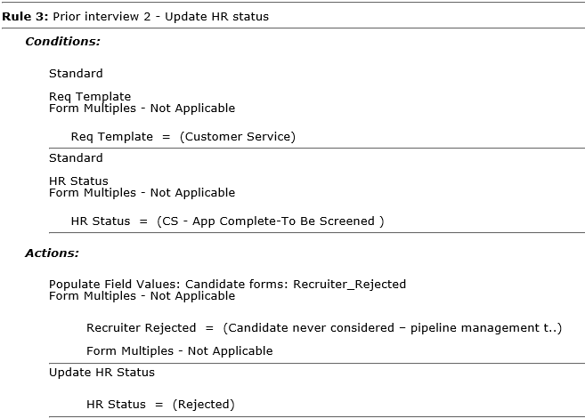
RAM Configuration

Slide 12
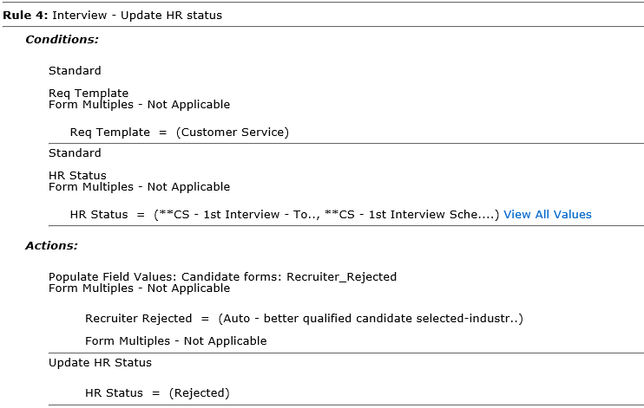
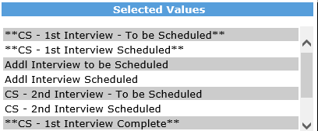
RAM Configuration

Slide 13
Auto Un-Post Requisitions
How does this work?
Can be different for each workflow – Care, Retail, Professional
All 3 look at if this is a sourcing req or not first as this does not apply to sourcing/evergreen reqs
Looks at the positions remaining on the Req Sub Form
Un-posts from all Talent Gateways specified
This does not have to be all of them and can be certain ones
2020 YTD Data
Trigger Name | # of Triggers run | Rules per Trigger | Total # of Rules run
HR Status - Sent Offer letter | 3,266 | 7 | 22,862
2019 Data
Trigger Name | # of Triggers run | Rules per Trigger | Total # of Rules run
HR Status - Sent Offer letter | 16,979 | 7 | 118,853

Slide 14
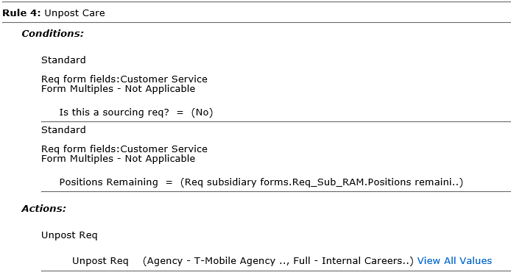
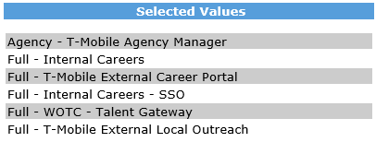
RAM Configuration

Slide 15
Auto Un-Post Requisitions
Retail has a specific and different one at HR Status: To be screened – Retail
Looks at Retail req template
Checks if it is a sourcing req or not
Checks Brand as we have a couple of different Brands and not all want this
Counts the number of people in To be screened – Retail
At 50 for the count, it will un-post the req from all Gateways specified
It also sends communications out
2020 YTD Data
Trigger Name | # of Triggers run | Rules per Trigger | Total # of Rules run
HR Status: To be screened - Retail | 39,950 | 2 | 79,900
2019 Data
Trigger Name | # of Triggers run | Rules per Trigger | Total # of Rules run
HR Status: To be screened - Retail | 171,601 | 2 | 343,202

Slide 16
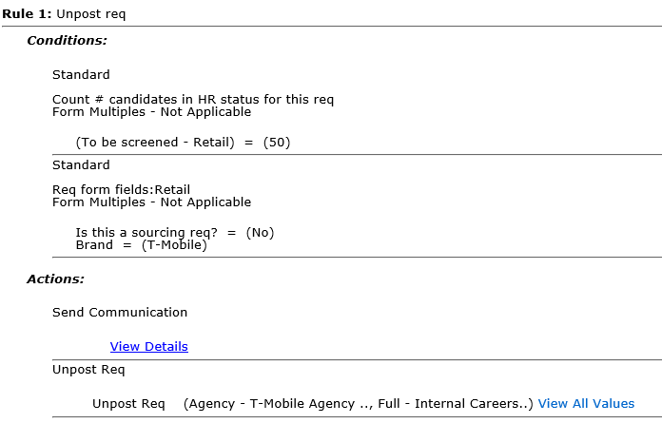
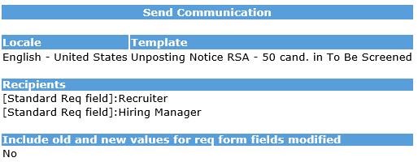
RAM Configuration

Slide 17
Let’s Talk!
Chrissy Lazzerini
Christina.Lazzerini@T-Mobile.com

