Slide 1
Hiring Automation
at Best Buy

Slide 2
Agenda
Best Buy RAM Overview
Offer and Employment Screening RAMs
Candidate Move RAM
Termed Employee RAMs
Initial Req/Intake Form process
Questions/Contact Info

Slide 3
Best Buy RAM Overview
Overall usage
Highest volume RAMs
Newest RAMs
128 currently active RAM triggers*
424 unique rules*
2019 usage
33,793,131 rules run
Estimated 604,818 hours saved
Estimated 39 FTEs saved
Application confirmation (5)
Turndown (15)
Interview scheduling (6)
Employment Screening (7)
Offer (12)
Hiring notifications/reminders (3)
Terminated employee (3)
Req stage creation
Offer Accepted in another req turndown
90 day check in
Text reminders
Req approval reminders
*As of 5/29/2020

Slide 4
Offer and Employment Screening RAMs
Business Need:
Offers
Additional Data
No time
Electronically view and accept offers in an engaging way
Capture candidate information in order to conduct employment screening
Store hiring leaders do not have to manage the process and follow up with their candidates

Slide 5
Offer and Employment Screening RAMs Solution
Document Sub Form used to capture electronic PDF (Document Template) offer letter signature.
Candidate Forms used to capture additional candidate information and background consent (required by law to be separate).

Slide 6
Offer and Employment Screening RAMs Solution
Total of 23 RAMs used to manage process
Notify candidates of offers and acceptance process, and candidate form for completion.
Review and monitor the 3 steps to ensure completion and, once complete, move them forward in the HR status workflow
If they have not been completed, reminder emails and texts (using TextRecruit) are sent to candidate at 24hr and 48hr after the offer is extended to have them complete the required next steps. Communications sent are specific and define the exact missing items.
Update HR status in other requisitions if they accept offer.
Conduct candidate and hiring manager surveys upon accepting offer.
Updates a form which tracks the steps of candidates offer so manager to easily monitor progress though the process.

Slide 7
Candidate Move RAM
Business Need:
Corporate
Legal
Experience
Hard to fill roles that passive candidates don’t want to apply
Tracking and approvals must be captured to move candidates between req folders.
System capability (no candidate actions needed) without granting additional access permissions to user

Slide 8
Candidate Move RAM Solution
Use a “Single per candidate/req combination” form with approvals included.
Recruiter can submit the specific candidate form for the candidate within the req they are managing.
Recruiter selects new req(s) and reason for move.
Captures candidate agreement to be moved.
Confirms job qualifications are met.
Form gets routed to TA manager for approval.
Upon approval, RAM copies the candidate and all relevant candidate forms to the new req.
LIVE DEMO

Slide 9
Terminated employee RAMs
Business need:
Ability to update hiring system with termination and employee data when employees leave the company.
Have historical employment information to be able to tie to future or current candidate application.
Ability to prevent applications or progress for past employees who are determined to be non-rehireable.
Real-time updates
Access
Compliance

Slide 10
Terminated employee RAMs Solution
Total of 7 RAMs used to manage process
Termination integration with Oracle using a “Multiple per candidate” form
RAM updates all current applications for employees that leave the company to the correct hiring workflow or pause the hiring process if beyond a certain point (e.g. Offer)
Notifies recruiting team of termination meeting
RAM to update a most recent term (“One per candidate” form) to allow the details to be outputable fields within candidate list
RAM checks applications at initial submission to determine if the employee is non-rehireable to stop the hiring process

Slide 11
Terminated employee RAMs Solution

Slide 12
Initial req/Intake form Process
Business need:
Two separate Talent Acquisition teams and processes
Need for more consistent, effective and engaging hiring manager experience
Solution needed to be flexible enough to work 2 varying processes (Field Leadership and Corporate).
Inaccurate data provided to TA, as other systems did not have live or updated information.
Expectations varied depending on relationship with TA Team Members
Initiating the recruitment process was inconsistent
Hand off between hiring manager, HR, and TA was clunky and inconsistent

Slide 13
Initial req/Intake form Solution
External req URL to kick off the request process
Utilize standard Req functionality
Hiring Manager view
Managers see specific fields only for them and do not see values that recruiters use to track and update reqs
Req approvals
Corporate process requires approvals for reqs but Field Leadership does not
Human Resource view
Adds additional detail for req like license plate tracking numbers, or other details for finance leaders and business leaders to review and approve roles
Talent Acquisition view
TA professionals see all most fields and are the final individuals to update the form and officially open and post the requisition
JCDD/RFAs
We use JCDD and multiple RFAs to assist the manager and hiring teams creating and managing the req
LIVE DEMO

Slide 14
Initial req/Intake form Solution
Total of 8 RAMs to manager initial process/communications
Approval routing (when needed)
We use the Req Approval Reminders to send business leaders a part of the approval process when they have not completed their decision on a submission
Recruiter req assignment
Triggered by Req edit, this is our most complicated RAM. This automation is used to route the req to the TA manager upon approval, and, once the req is assigned, manage notifications to the recruiter (immediately) and manager (using req sub form - below).
HM confirmation message
To manage the timing of delivery, a Req sub form insert is used to delay messaging to manager (8 hrs later) and the communication requests that they set up a strategy meeting with their assigned recruiter.
Job posting confirmation
After TA aligns with manager (strategy meeting), they can open and post the job. Once posted, the system sends manager confirmation using a Job Post RAM the req is posted with links they can use to share the job with their network.

Slide 15
Questions? MatthewHR.Johnson@bestbuy.com

Slide 16
Appendix

Slide 17
Candidate move screenshots
Candidate form
Candidate action log

Slide 18
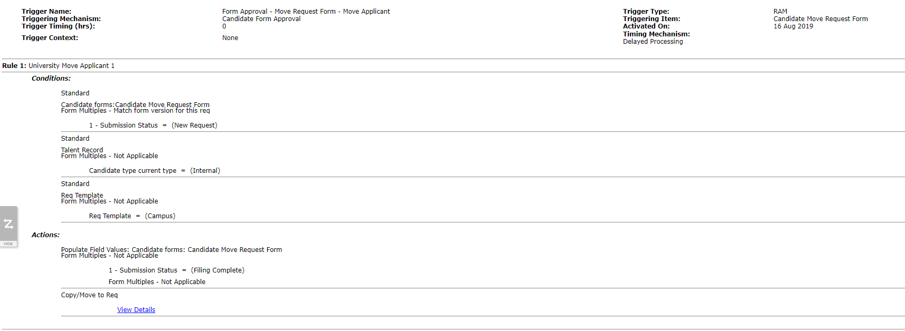
Candidate move screenshots
RAM

Slide 19
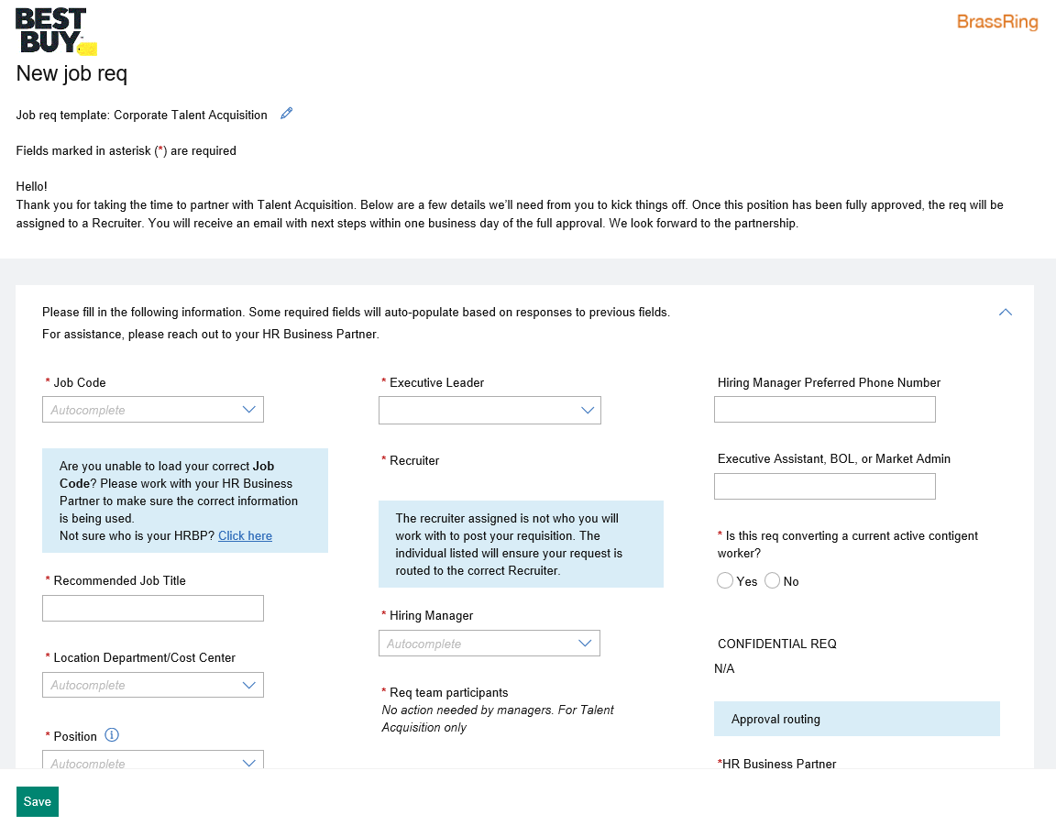
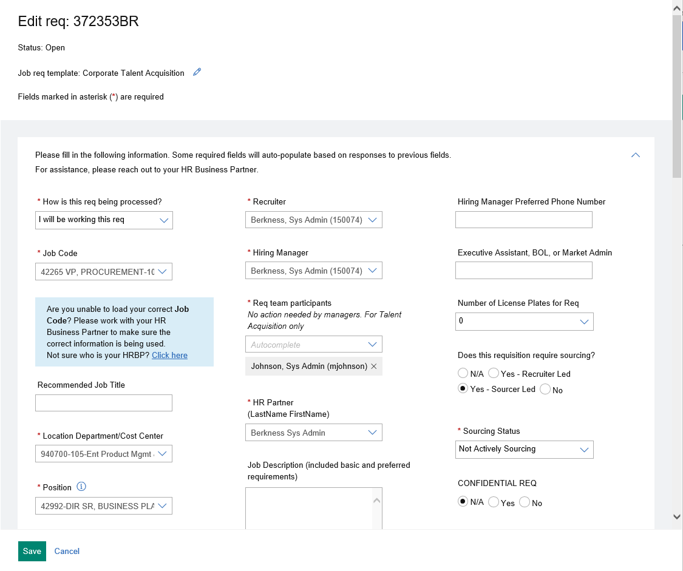
Initial req/Intake form screenshots
Manager/Initial Submission view
Talent Acquisition view

Slide 20
Initial req/Intake technical diagram

