Slide 1
Interview Manager Visualizations in the Metrics Dashboard IBM Kenexa BrassRing on Cloud — Client Training and Enablement Session IBM Talent Management Solutions August 18th, 2020

Slide 2
Agenda
Benefits
Demo
Resources
Configuration steps

Slide 3
Benefits
Metrics Dashboard:
Visual dashboards for leadership to view data across the organization.
Identify areas where efficiency is needed.
Dashboards for Recruiters and Managers to view statistics relevant to them.
Interview Manager:
Pulls the interview scheduling function into BrassRing instead of working in a separate system or via email.
Allows for many different interview styles.
Integrated with Outlook 360 and Google Calendars, allowing easy review of calendars when scheduling.
Streamlines communications around the interview step.
Creating visualizations in the Metrics Dashboard can give the organization a holistic view of the number of interviews occurring, what their statues are, what is upcoming, and how many interviews have been completed. This can allow a Talent Acquisition team to forecast recruitment efforts moving forward and give an accurate view of resource time spent performing interviews.

Slide 4
Resources
Metrics Dashboard:
https://www.ibm.com/support/knowledgecenter/SSEUFV/7_Reporting/2_TheMetricsDashboard/top.html
Interview Manager:
https://www.ibm.com/support/knowledgecenter/SSEUFV/16_InterviewManagement/top.html
Example Interview Manager Visualizations in the Metrics Dashboard:
https://www.ibm.com/support/knowledgecenter/SSEUFV/7_Reporting/2_TheMetricsDashboard/4_ExampleVisualizations.html?view=kc#ID-1122-00000002__18

Slide 5
Demo –

Slide 6
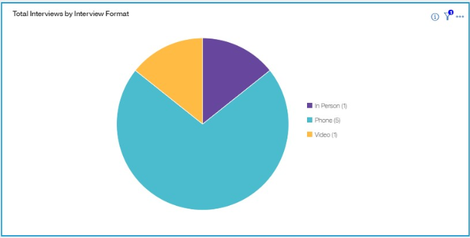
Total Number of Interviews by Interview Style
Interview Visualizations in the Metrics Dashboard
Visualization Type: Pie
Visualization Pane:
Slices: Interview Style
Show slices by: Total Interviews
Filters: Interview Date

Slide 7
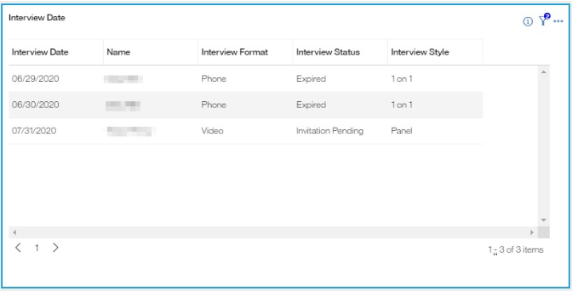
Upcoming Interviews
Interview Visualizations in the Metrics Dashboard
Visualization Type: Table
Visualization Pane:
Columns: Interview Date, Name (Candidate), Interview Format, Interview Status, and Interview Style
Filters: Interview Date, and Interview Status

Slide 8
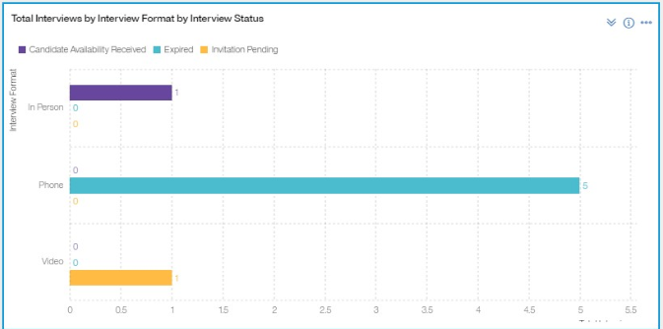
Total Interviews by Interview Format
Interview Visualizations in the Metrics Dashboard
Visualization Type: Stacked Bar Chart
Visualization Pane:
Rows: Interview Format, and Interview Style
Columns: Total Interviews
Divide Columns by: Interview Status

Slide 9
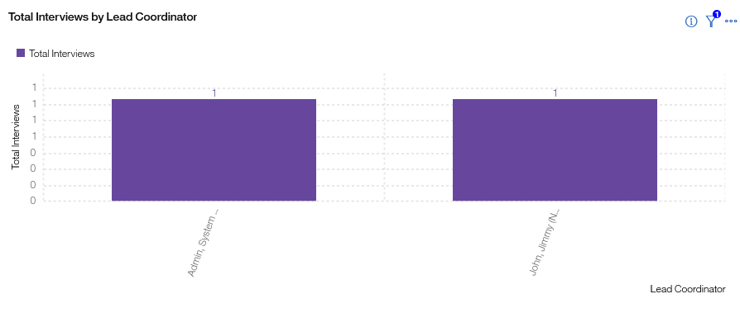
Total Interviews by Lead Coordinator
Interview Visualizations in the Metrics Dashboard
Visualization Type: Clustered Bar Chart
Visualization Pane:
Rows: Lead Coordinator
Columns: Total Interviews
Filter: Interview Status (Scheduled)

Slide 10
Other Visualizations
Interview Visualizations in the Metrics Dashboard
Total Interviews by Interviewer (Invite Sent - Interviewer)

Slide 11
Questions?

