Slide 1
Interview Manager Rescheduling IBM Kenexa BrassRing on Cloud — Client Training and Enablement Session IBM Talent Management Solutions October 27th, 2020

Slide 2
Agenda
Overview
Type of Interviews
Demo
Resources
Q n A

Slide 3
Overview
Interview Manager:
Rescheduling allows users to reschedule an existing interview without cancelling it.
It saves time & effort of interview coordinators.
All the 3 interview types* can now be rescheduled.
A new communication must be sent to the affected candidate/interviewers.
*Interview type – “Verify Interviewers availability first” - Rescheduling is available only in staging as of today. It will be released to production in a future release. Watch for updates in our Release Notes!

Slide 4
Rescheduling Interviews: Confirmed Date & Time
Rescheduling for Schedule Type: Confirmed Date & Time
Rescheduling can be done from the Interviews Tab on the BrassRing home page or from the card view in the Manage Interviews section of BrassRing.
For interviews meeting the criteria, a Reschedule Interview button is displayed in the Interview details section.

Slide 5
Confirmed Date & Time
Rescheduling is available in the following statuses:
Invitation Sent
Invitation Accepted - Candidate
Invitation Declined - Candidate
Invitation Declined - Interviewer
Invitation Declined
Interview Scheduled
Rescheduling is Not Available in the following statuses:
Invitation Pending (in this case, "Manage Schedules" action displays instead)
Canceled (no edits allowed at this status)
Completed (no edits allowed at this status)
On-Hold (no edits allowed at this status)

Slide 6
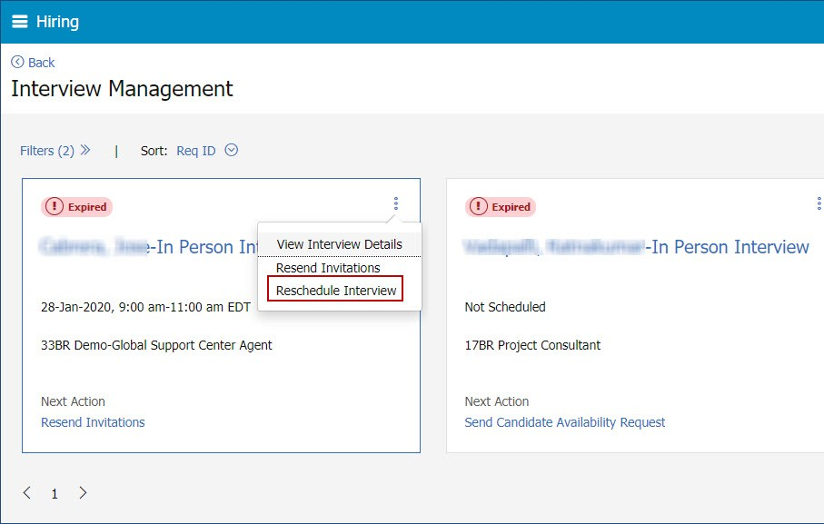
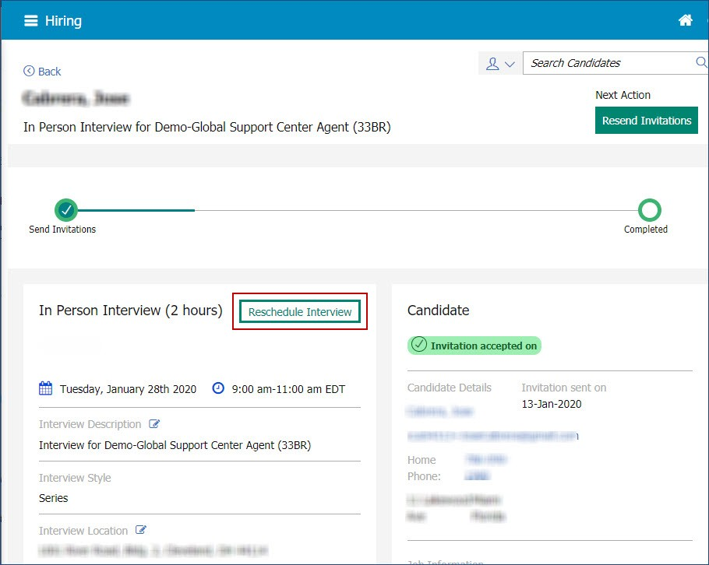
Confirmed Date & Time
Selecting Reschedule Interview in any of the screens displays the Manage Schedules page.
On the Manage Schedules screen, the information from the previous interview like, the name of the interviewer etc, is retained.
The interviewer name, interview duration, time slots, can be changed.
Details like the type of interview, and schedule type cannot be changed.
Based on the changes made to the interview schedule, a communication must be sent to the impacted interviewers and candidates.
Similarly, based on the actions taken by the user, alert messages are displayed to the user on screen.

Slide 7
Demo –

Slide 8
Reschedule Interviews: Ask Candidate First
Rescheduling for Schedule Type: Ask Candidate First
Rescheduling can be done from the section level button on the Interview details page, Card level action or grid level action on the interview listing page.
For interviews meeting the criteria, a Reschedule Interview button is displayed in the Interview details section.

Slide 9
Ask Candidate First
Rescheduling is available in the following statuses:
Candidate availability received
Candidate availability declined
Invitation Pending
Invitation Sent
Invitation Accepted -Candidate
Invitation Declined - Interviewer
Invitation Declined - Candidate
Interview Scheduled
Candidate availability requested
Rescheduling is Not Available in the following statuses:
To Be Scheduled (edits allowed, but no reschedule because nothing has been sent)
Canceled (no edits allowed at this status)
Completed (no edits allowed at this status)
On-Hold (no edits allowed at this status)

Slide 10
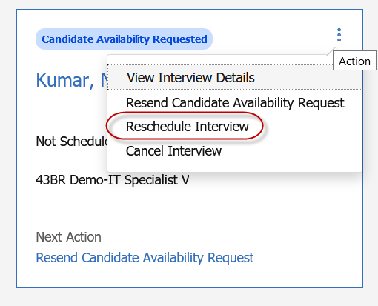
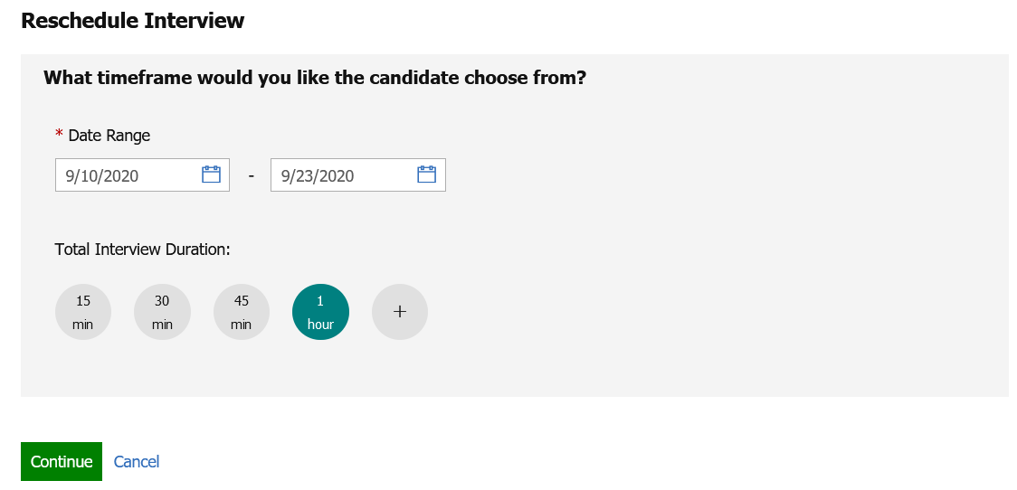
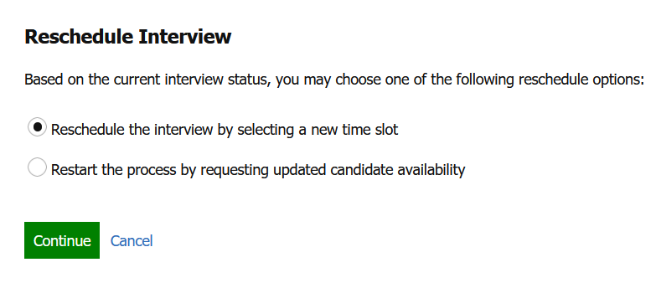
Ask Candidate First
Selecting Reschedule Interview in any of the screens displays the appropriate “Reschedule Interview” page depending upon the Interview Status.
On the Reschedule Interview screen, 2 workflows can be followed:
Reschedule the interview by selecting a new timeslot
Restart the process by requesting updated candidate availability
The interviewer name, interview duration, time slots, can be changed.
Details like the type of interview, and schedule type cannot be changed.
Based on the changes made to the interview schedule, a communication must be sent to the impacted interviewers and candidates.
Similarly, based on the actions taken by the user, alert messages are displayed to the user on screen.

Slide 11
Demo –

Slide 12
Reschedule Interviews: Verify interviewer availability first (Available in Staging Only)
Rescheduling for Schedule Type: Verify interviewer availability first
Rescheduling can be done from the section level button on the Interview details page, Card level action or grid level action on the interview listing page.
For interviews meeting the criteria, a Reschedule Interview button is displayed in the Interview details section.
*Rescheduling for this Schedule Type is available only in staging as of today. It will be released to production in a future release. Watch for updates in our Release Notes!

Slide 13
Verify interviewer availability first
Rescheduling is available in the following statuses:
Candidate availability received
Candidate availability declined
Invitation Pending
Invitation Sent
Invitation Accepted -Candidate
Invitation Declined - Interviewer
Invitation Declined - Candidate
Interview Scheduled
Candidate availability requested
Rescheduling is Not Available in the following statuses:
To Be Scheduled (edits allowed, but no reschedule because nothing has been sent)
Canceled (no edits allowed at this status)
Completed (no edits allowed at this status)
On-Hold (no edits allowed at this status)

Slide 14
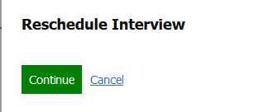
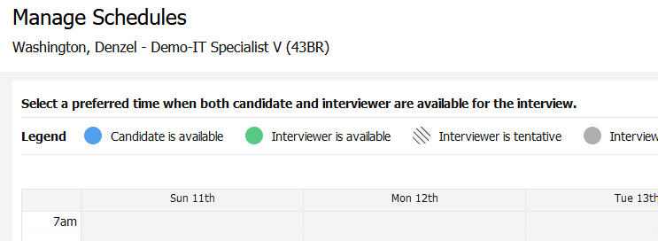
Verify interviewer availability first
Selecting Reschedule Interview in any of the screens displays the appropriate “Reschedule Interview” page depending upon the Interview Status.
On the Reschedule Interview screen, 2 workflows can be followed:
Reschedule the interview by selecting a new timeslot
Restart the process of requesting candidate availability by selecting interviewer available times
The interviewer name, interview duration, time slots, can be changed.
Details like the type of interview, and schedule type cannot be changed.
Based on the changes made to the interview schedule, a communication must be sent to the impacted interviewers and candidates.
Similarly, based on the actions taken by the user, alert messages are displayed to the user on screen.

Slide 15
Demo –

Slide 16
Resources
Rescheduling Interviews:
https://www.ibm.com/support/knowledgecenter/en/SSEUFV/16_InterviewManagement/1_CreateAndManageInterviews.html#Onboard_Login_and_Navigation_eLearning__12
Interview Manager:
https://www.ibm.com/support/knowledgecenter/SSEUFV/16_InterviewManagement/top.html
Example Interview Manager Visualizations in the Metrics Dashboard:
https://www.ibm.com/support/knowledgecenter/SSEUFV/7_Reporting/2_TheMetricsDashboard/4_ExampleVisualizations.html?view=kc#ID-1122-00000002__18

Slide 17
Questions & Answers?

